Slide 1
American Association of Neuropathologists (AANP) 2023 ANNUAL DIAGNOSTIC SLIDE SESSION Cassie B. MacRae, M.D. & Isaac Solomon, M.D., Ph.D. Department of Pathology Brigham and Women’s Hospital & Harvard Medical School Boston, MA

Slide 2
Clinical History
25-year-old previously healthy male, suffered a seizure while playing video games at home
Head MRI: Left inferior parietal lesion, 1.6 cm cystic intraparenchymal lesion, low-grade glioma vs DNET
He was started on levetiracetam, followed with serial imaging and scheduled for surgical resection
Five months later, the patient presented with a new scalp lesion (initially tender, without erythema or discharge)
MRI showed a 1.2 x 1.6 cm right frontal lesion with enhancement of the adjacent scalp, loss of the subjacent right frontal calvarial cortex, and thickening and enhancement of the underlying right frontal dura.
His previously demonstrated cystic intraparenchymal lesion in the inferior left parietal lobe was unchanged/stable in appearance.

Slide 3
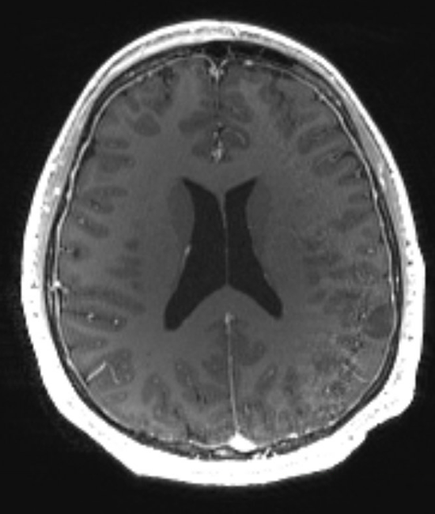
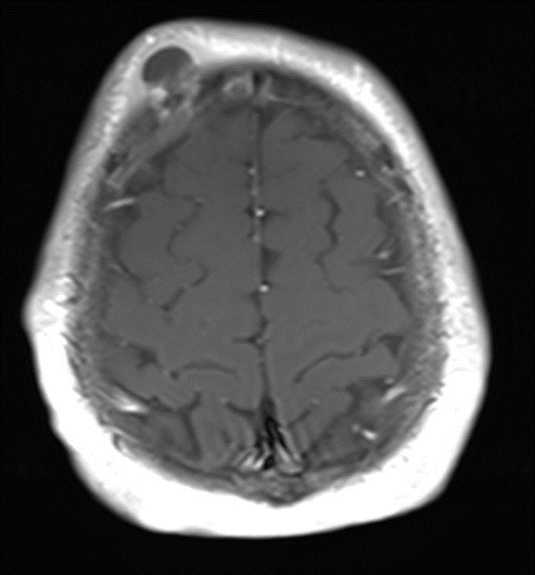
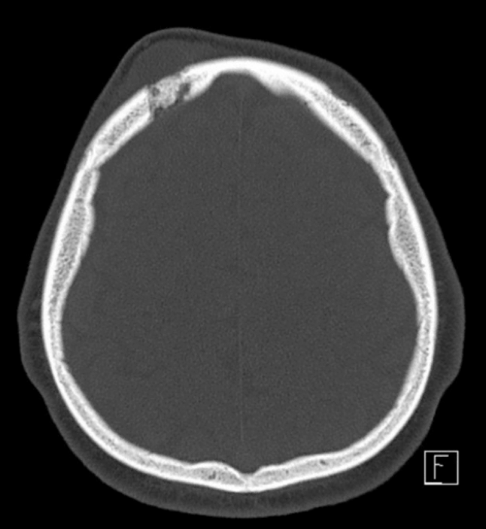

Slide 4
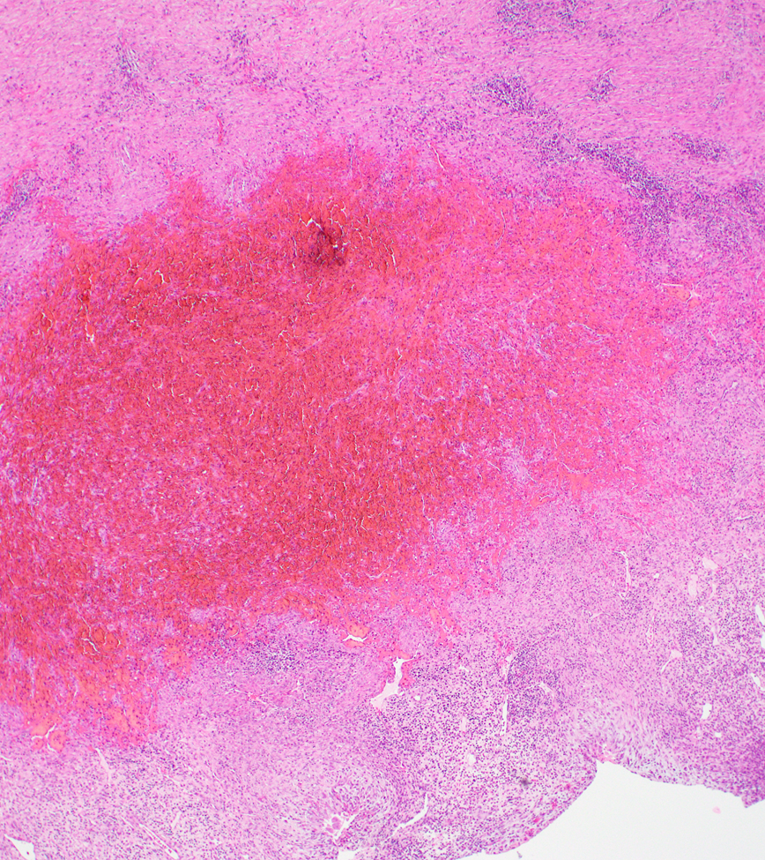
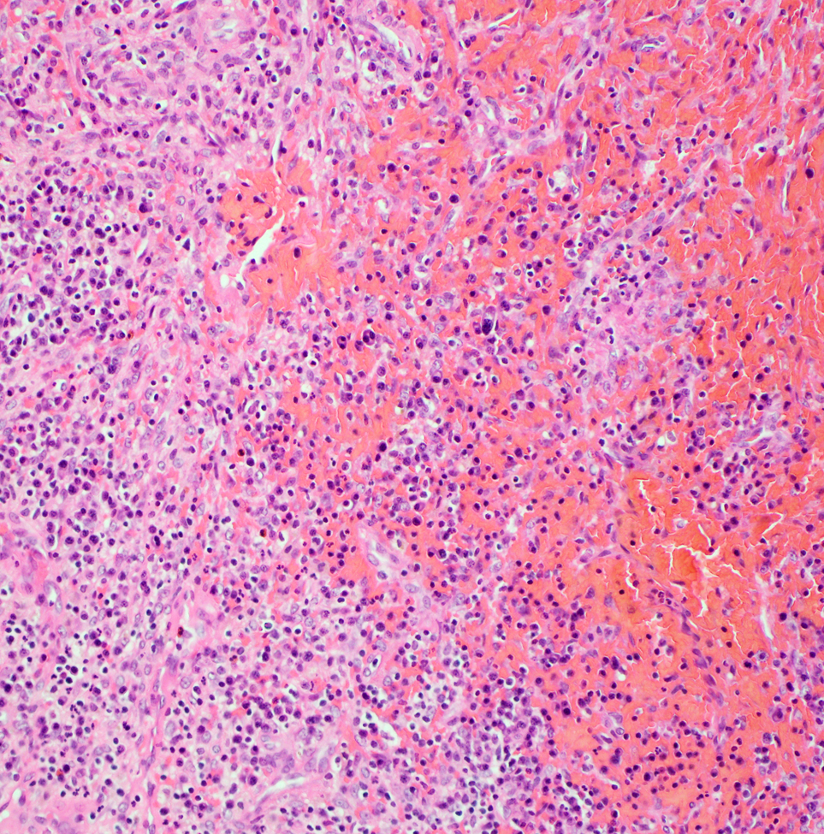
Right Frontal Lesion (H&E)

Slide 5
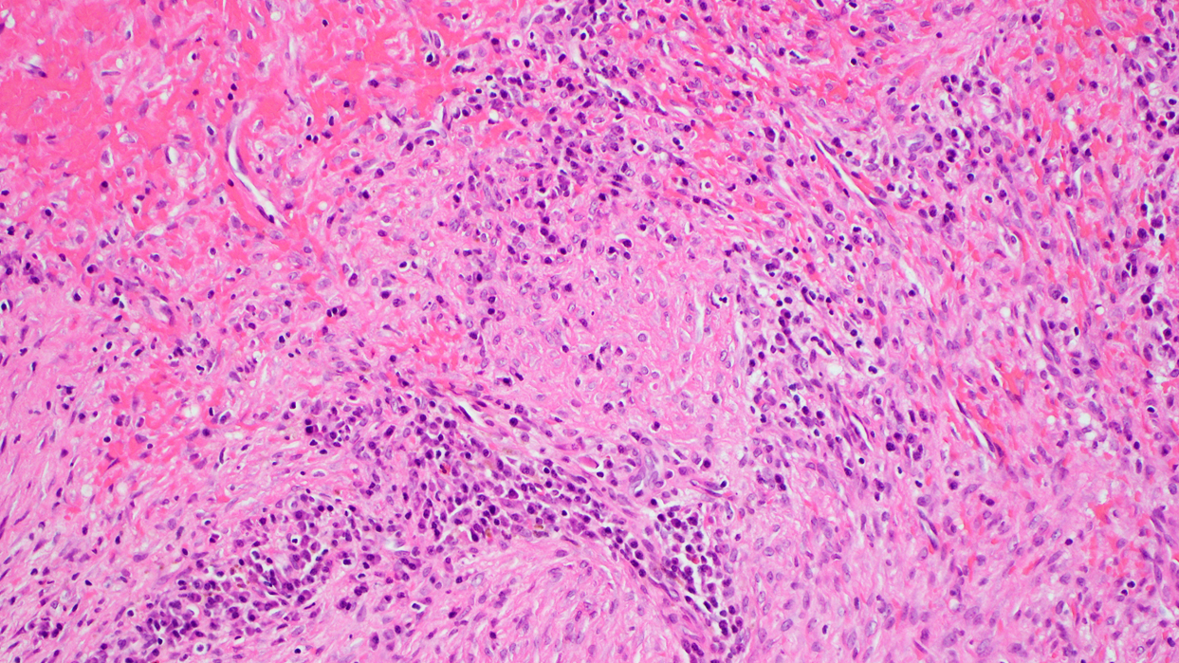
Right Frontal Lesion (H&E)

Slide 6
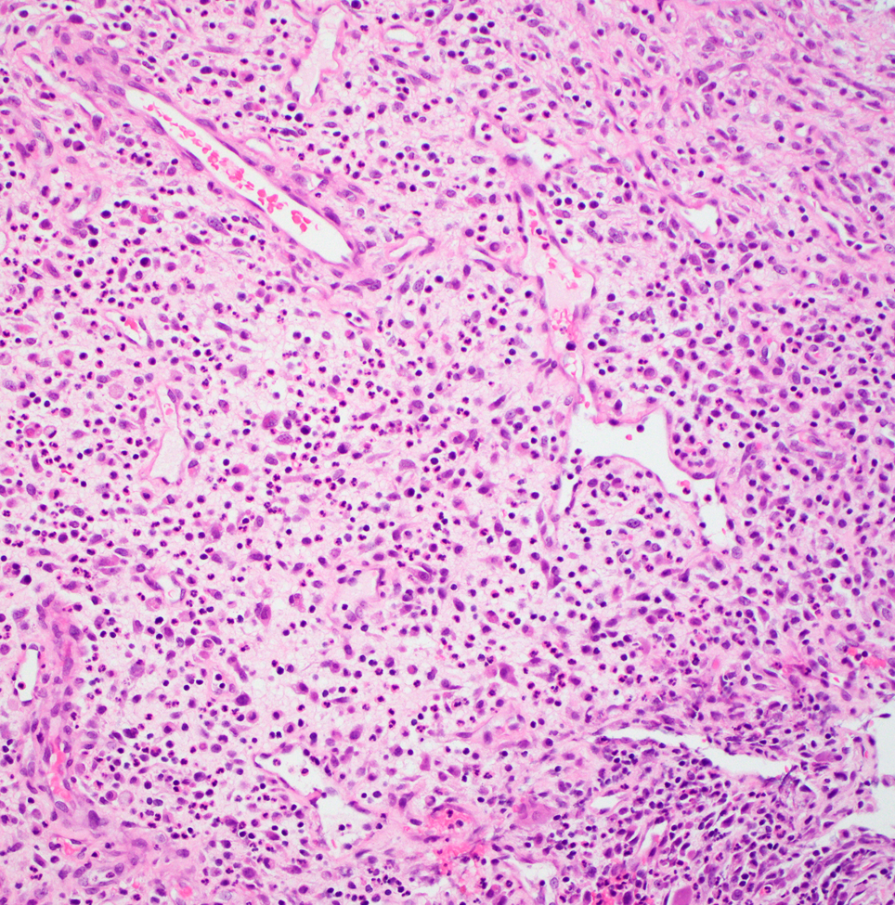
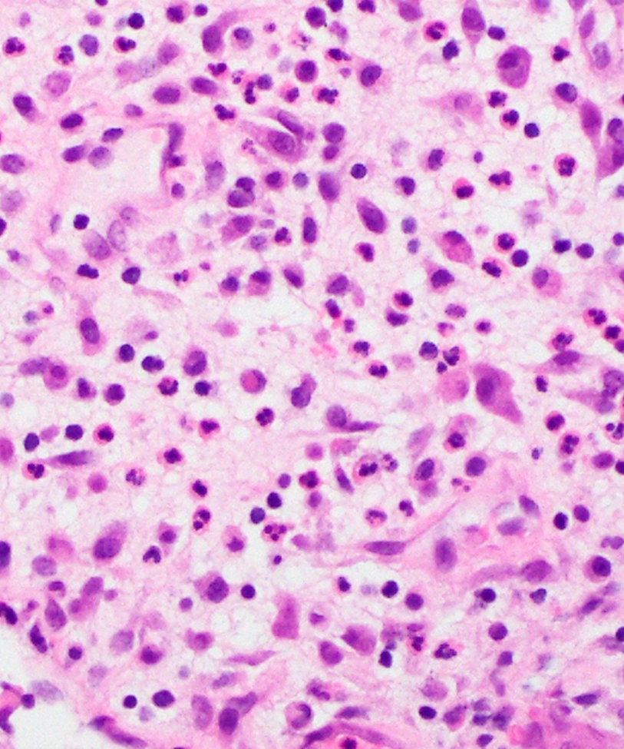
Right Frontal Lesion (H&E)

Slide 7
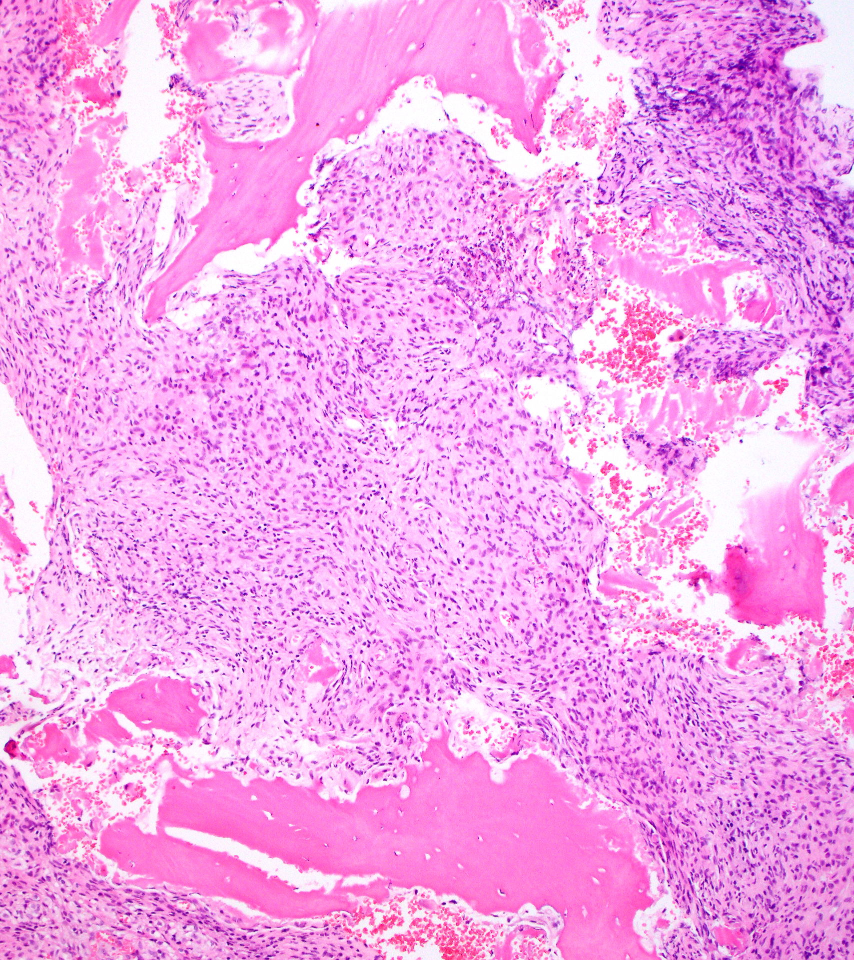
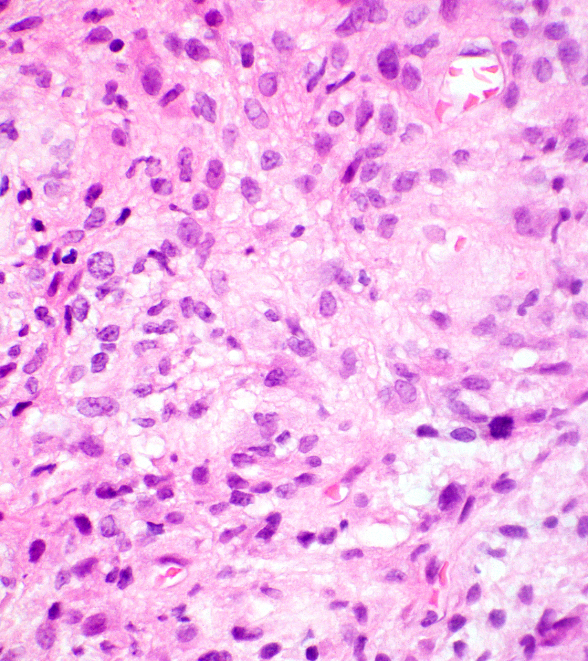
Right Frontal Bony Lesion (H&E)

Slide 8
Diagnosis?

Slide 9
Right Frontal Lesion (H&E)

Slide 10
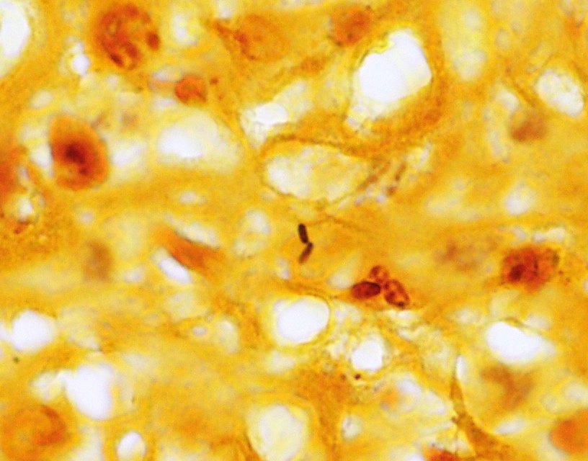
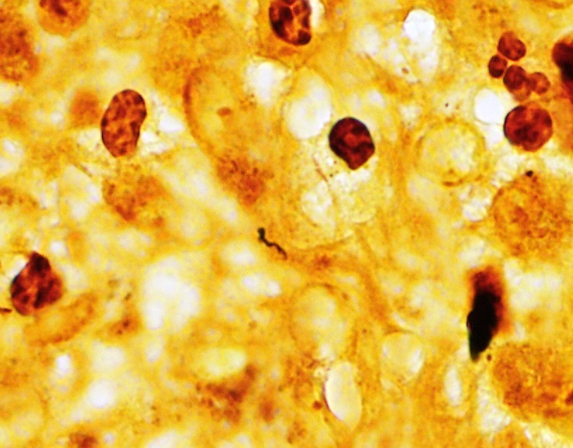
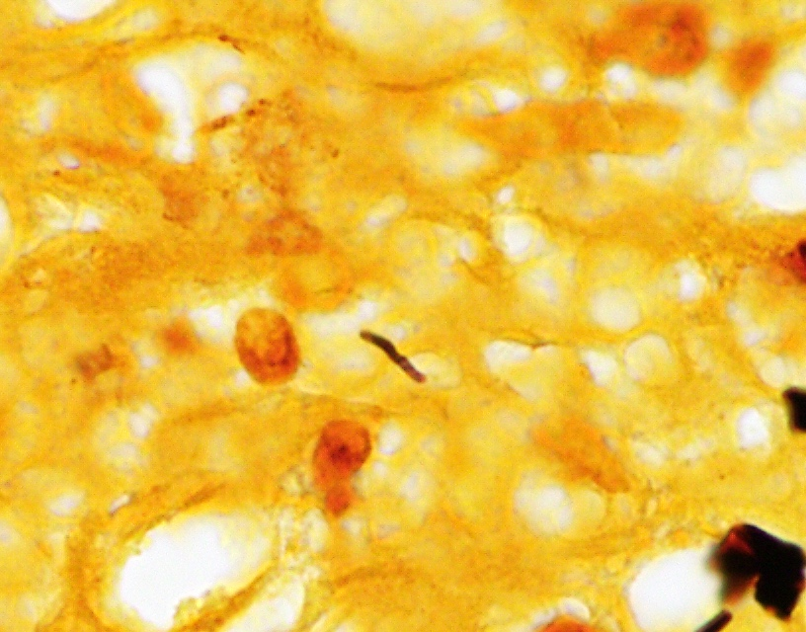
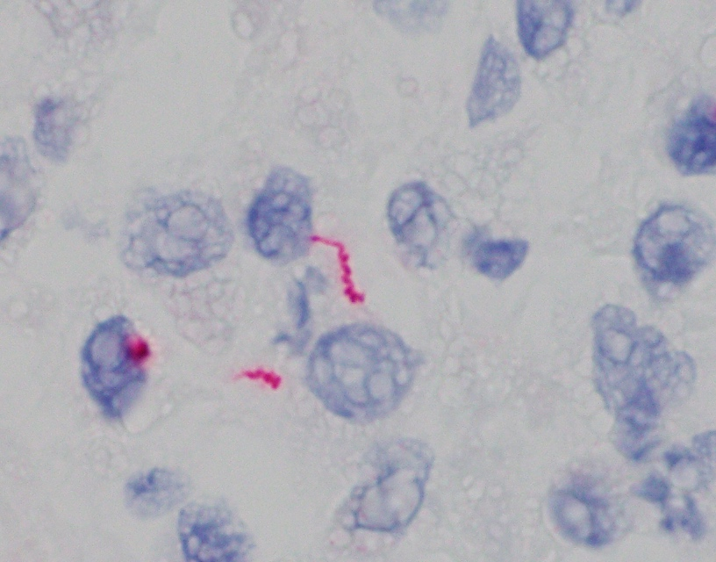
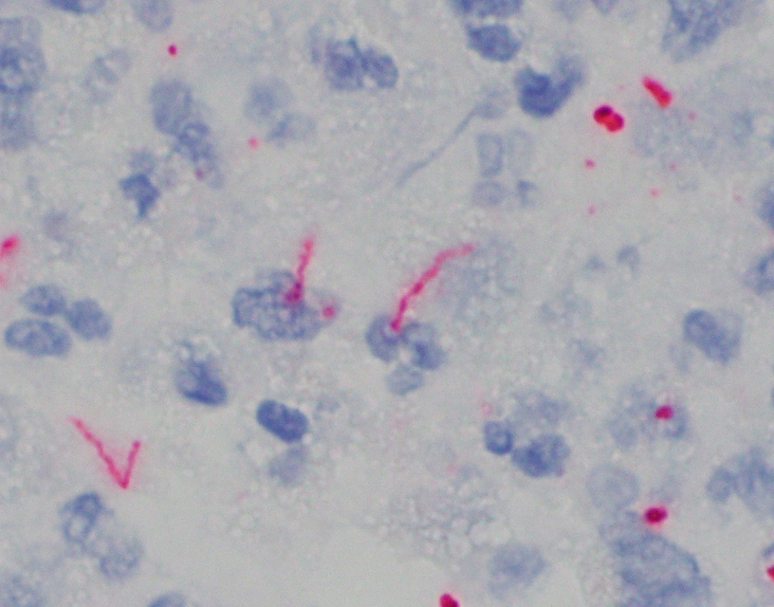
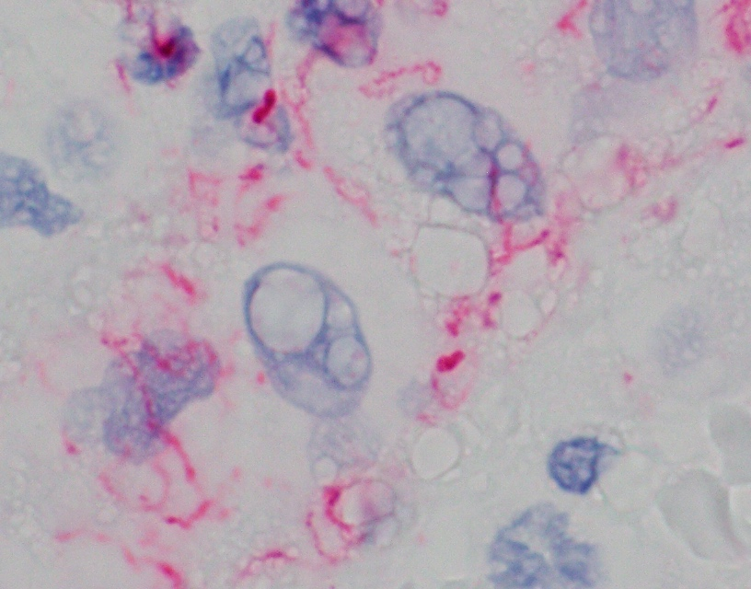
Warthin-Starry
Spirochete IHC

Slide 12
Laboratory Testing
Treponema pallidum particle agglutination (TP-PA) positive
Rapid plasma reagin (RPR) positive (1:64)
HIV-1 negative (antigen, antibody, viral load)
Chlamydia trachomatis and Neisseria gonorrhoeae nucleic acid detection negative

Slide 13
Treatment & Follow-Up
Prior to developing scalp mass - patient reported experiencing diffuse, red, flat, non-pruritic rash on his chest, arms, and extremities
He attributed rash to allergic reaction, which resolved shortly after treatment with diphenhydramine HCl
Admitted for initiation of high-dose intravenous penicillin therapy for syphilitic osteomyelitis of the skull.
Given proximity to dura, he was treated with penicillin G 6,000,000 units IV every 4 hours or 24,000,000 units / 24 hours by continuous infusion for 14 days followed by a dose of benzathine PCN in clinic.
Patient doing well since last follow-up with infectious disease clinic
Urine and rectal gonorrhea swabs were positive, treated with ceftriaxone.
Doing well on HIV PrEP without side effects.
RPR trending down to 1:8 after 3 months and 1:4 after 4 months (initially at 1:64)
Subsequent resection of left parietal lobe lesion
Dx: Low-grade glial/glioneuronal tumor

Slide 14
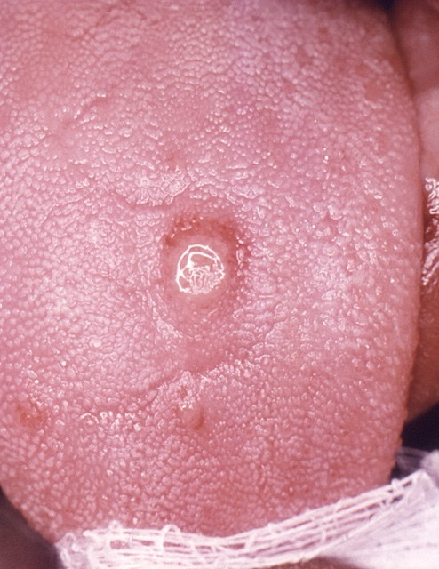
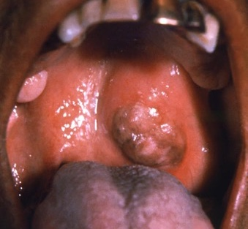
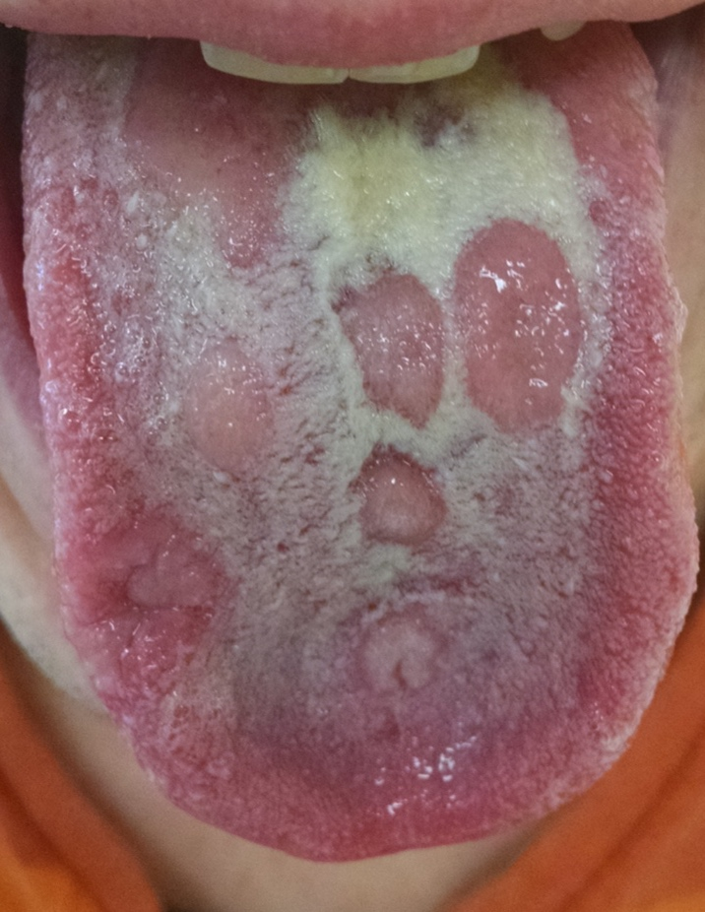
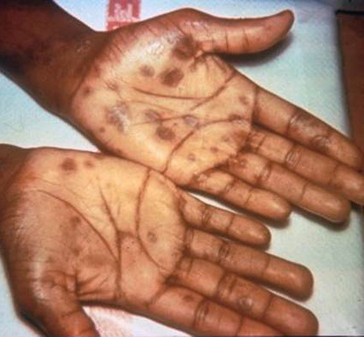
Syphilis
Epidemiology (US)
~130,000 reported cases in 2019
47% of primary/secondary cases in MSM
>2,000 congenital cases in 2020
Stages
Primary: firm, round, painless chancre near site of entry lasting 3-6 weeks
Secondary: while primary chancre healing or several weeks after; skin rashes on palms/soles and/or mucous membrane sores; condyloma lata
Latent: no visible signs or symptoms
Tertiary:10-30 years after infection; gummas can involve multiple body sites including bone
https://www.cdc.gov/std/syphilis/

Slide 15
Secondary and early neurosyphilis with uveititis and four osseous lesions of skull in a 50 year old woman
Syphilitc gumma in a 56 year old man with a history of treated syphilis who presented with seizures and confusion
Meningovascular syphilis presenting as a mass forming brain lesion in HIV-negative 25 year old man with no prior history of syphilis
Kusler and Arthurs. Case Rep Infect Dis. 2018 May 8;2018:3148758.
Fargen et al. Neurosurgery. 2009 Mar;64(3):568-75
Pham et al. Open Forum Infect Dis. 2021 Aug 31;8(9):ofab455.

Slide 16
Take Home Points
Bone involvement in syphilis is rare, usually occurring in tertiary or congenital cases
Broad differential diagnosis for osteolytic lesions of skull:
metastases, pyogenic osteomyelitis, multiple myeloma, lymphoma, tuberculosis, leukemia, and Langerhans cell histiocytosis
Diagnosis typically requires:
high degree of clinical suspicion
serological testing
biopsy with demonstration of organisms or positive molecular testing
Treatment consists of high dose penicillin to prevent neurosyphilis and other severe manifestations

Slide 17
Thank you!

