Slide 1
AANP 66th Annual Diagnostic Slide Session CASE 11
Lakshmi Shree K. Mahadevan, MD
Clinical Neuropathology Fellow
Jamie Walker, MD-PhD
Associate Professor Neuropathology

Slide 2
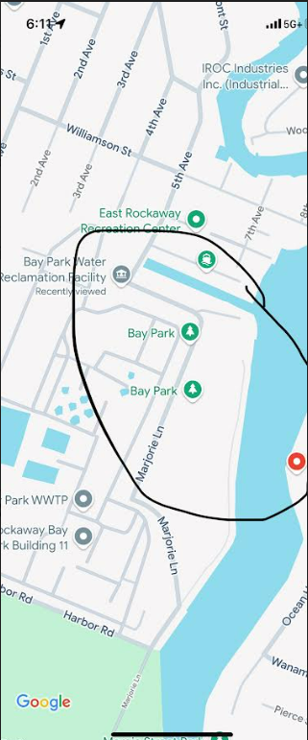
Clinical information
59-year-old female with 3 days of nausea, vomiting, hoarseness and dysphagia
Intermittent fevers 3 weeks prior to this presentation
On exam: Decreased left trigeminal nerve (V2/V3) sensation, hypophonic voice (vocal cord paralysis), and nystagmus
H/o swimming and kayaking near a sewage treatment plant
Extensive travel history
Shortly after initial presentation, she had acute respiratory failure with decline on neurological examination

Slide 3
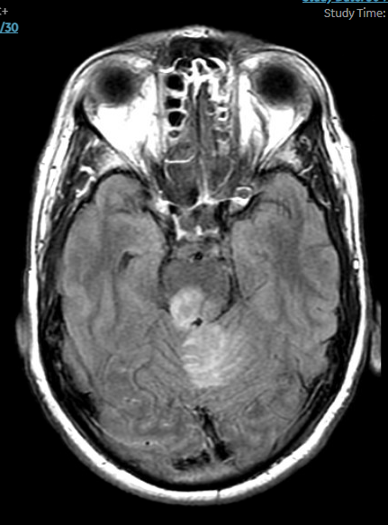
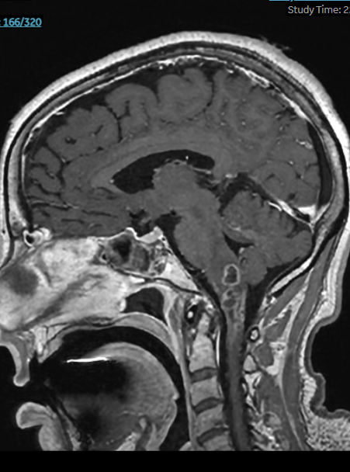
MRI findings
A
1.6 cm peripherally enhancing lesion in the dorsal left medulla and cervicomedullary junction with central restricted water diffusion
Linear enhancement along the left trigeminal nerve root entry zone with leptomeningeal enhancement
Axial T2 FLAIR
Sagittal T1 post contrast

Slide 4
Histology
Notes:
Histiocytic infiltrate and necrosis with acute inflammation
Possible amoeba like organisms on frozen section

Slide 5
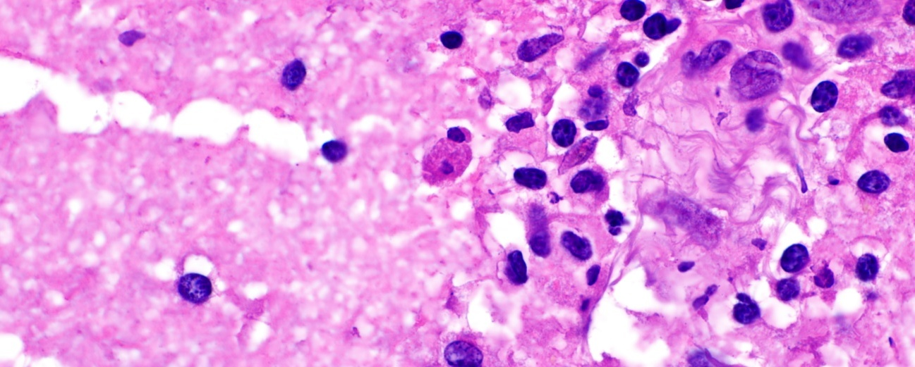
Histology
Notes:
Macrophages engulfing RBCs

Slide 6
Histology

Slide 7
Diagnosis ?
Diagnostic tests ?

Slide 8
Immunohistochemistry and special stains
CD68
GMS

Slide 9
Immunohistochemistry and special stains
Luxol fast blue/H&E
Neurofilament

Slide 10
Differential diagnosis
Infectious meningoencephalitis
Viral brainstem encephalitis
Amoebic meningoencephalitis
Listeria rhombencephalitis
Demyelinating disease (ADEM, MS variant)

Slide 11
Infectious Workup
Test | Result | Interpretation
SV40 (JC virus) IHC | Negative | Excludes PML
HSV-1 / HSV-2 IHC | Negative | Excludes herpetic encephalitis
VZV IHC | Negative | Excludes zoster encephalitis
Spirochete IHC | Negative | No evidence of neurosyphilis
AFB stain | Negative | No mycobacteria
Gram stain | Negative | No bacterial organisms seen
GMS / PAS | Negative | No fungal elements or amoeba cysts
CSF Meningoencephalitis PCR panel | Negative | No common pathogens detected
NMO / MOG Antibodies (Mayo Panel) | Negative | Excludes demyelinating diseases

Slide 12
Additional testing
Specimen was sent to CDC to test for amoeba and to Mayo clinic labs for broad range bacterial PCR and sequencing
Result:
Negative for Naegleria fowleri, Acanthamoeba and Balamuthia mandrillaris
Positive for Listeria Monocytogenes

Slide 13
Follow up
Patient completed 10 w course of IV Ampicillin
Impaired mobility
Developed autonomic dysfunction and hypotension
Diaphragmatic paralysis requiring stimulator placement
B/L Exposure keratopathy requiring tarsoraphy
Patient has been to rehab multiple times
Respiratory status: stable on BIPAP
Residual dysarthria

Slide 14
Listeria meningoencephalitis
3rd most common cause of bacterial meningitis
Transmitted by contaminated food (meat and poultry)
Cerebritis is rare-immunocompromised host
Rhombencephalistis can occur in immunocompetent host
Invades cranial nerves via retrograde axonal transport
Efferocytosis: Engulfment of red blood cells and debris by macrophages in necrotic and inflamed areas, cell to cell spread by pore forming toxins from bacteria
Granulomatous inflammation less common, may be observed in immunocompromised

Slide 15
Conclusion
Listeria rhombencephalitis is a distinct entity that can affect immunocompetent individuals, unlike Listeria cerebritis
The histology and clinical context raised consideration of primary amoebic meningoencephalitis
L. monocytogenes may reach the brainstem via the trigeminal nerve through damaged oropharyngeal mucosa, or via the vagus nerve through enteric neurons
CSF PCR may be negative in axonal transport–mediated spread, unlike ventriculitis
High-resolution MRI is critical to detect cranial nerve involvement

Slide 16
References
Wei P, Bao R, Fan Y. Brainstem Encephalitis Caused by Listeria monocytogenes. Pathogens. 2020 Aug 30;9(9):715. doi: 10.3390/pathogens9090715. PMID: 32872638; PMCID: PMC7558588.
Engelen-Lee JY, Koopmans MM, Brouwer MC, Aronica E, van de Beek D. Histopathology of Listeria Meningitis. J Neuropathol Exp Neurol. 2018 Oct 1;77(10):950-957. doi: 10.1093/jnen/nly077. PMID: 30169667; PMCID: PMC6140438.
Disson O, Lecuit M. Targeting of the central nervous system by Listeria monocytogenes. Virulence. 2012 Mar-Apr;3(2):213-21. doi: 10.4161/viru.19586. Epub 2012 Mar 1. PMID: 22460636; PMCID: PMC3396700.
Guarner, J., Bartlett, J., Shieh, WJ. et al. Histopathologic spectrum and immunohistochemical diagnosis of amebic meningoencephalitis. Mod Pathol 20, 1230–1237 (2007). https://doi.org/10.1038/modpathol.3800973

